Slide 1
Microsoft Foundry Part 1

Slide 2
Agenda
Microsoft Foundry
Overview
What is it?
Why do you care?
Essentials
Configuring in Azure
Simple Chatbot
Structured Output JSON

Slide 3

Overview

Slide 4
Microsoft Foundry - Overview
What is it?
Unified AI Platform
End-to-end AI development
Low-code/no-code prompt flow workflows
SDKs
Experimentation & Deployment
Test ideas in the playground
Deploy to the cloud

Slide 5
Microsoft Foundry - Overview
Why do you care?
Accelerate development of AI powered solutions
Highly available infrastructure
One stop place to organize, manage and maintain
Your Azure based AI solutions

Slide 6

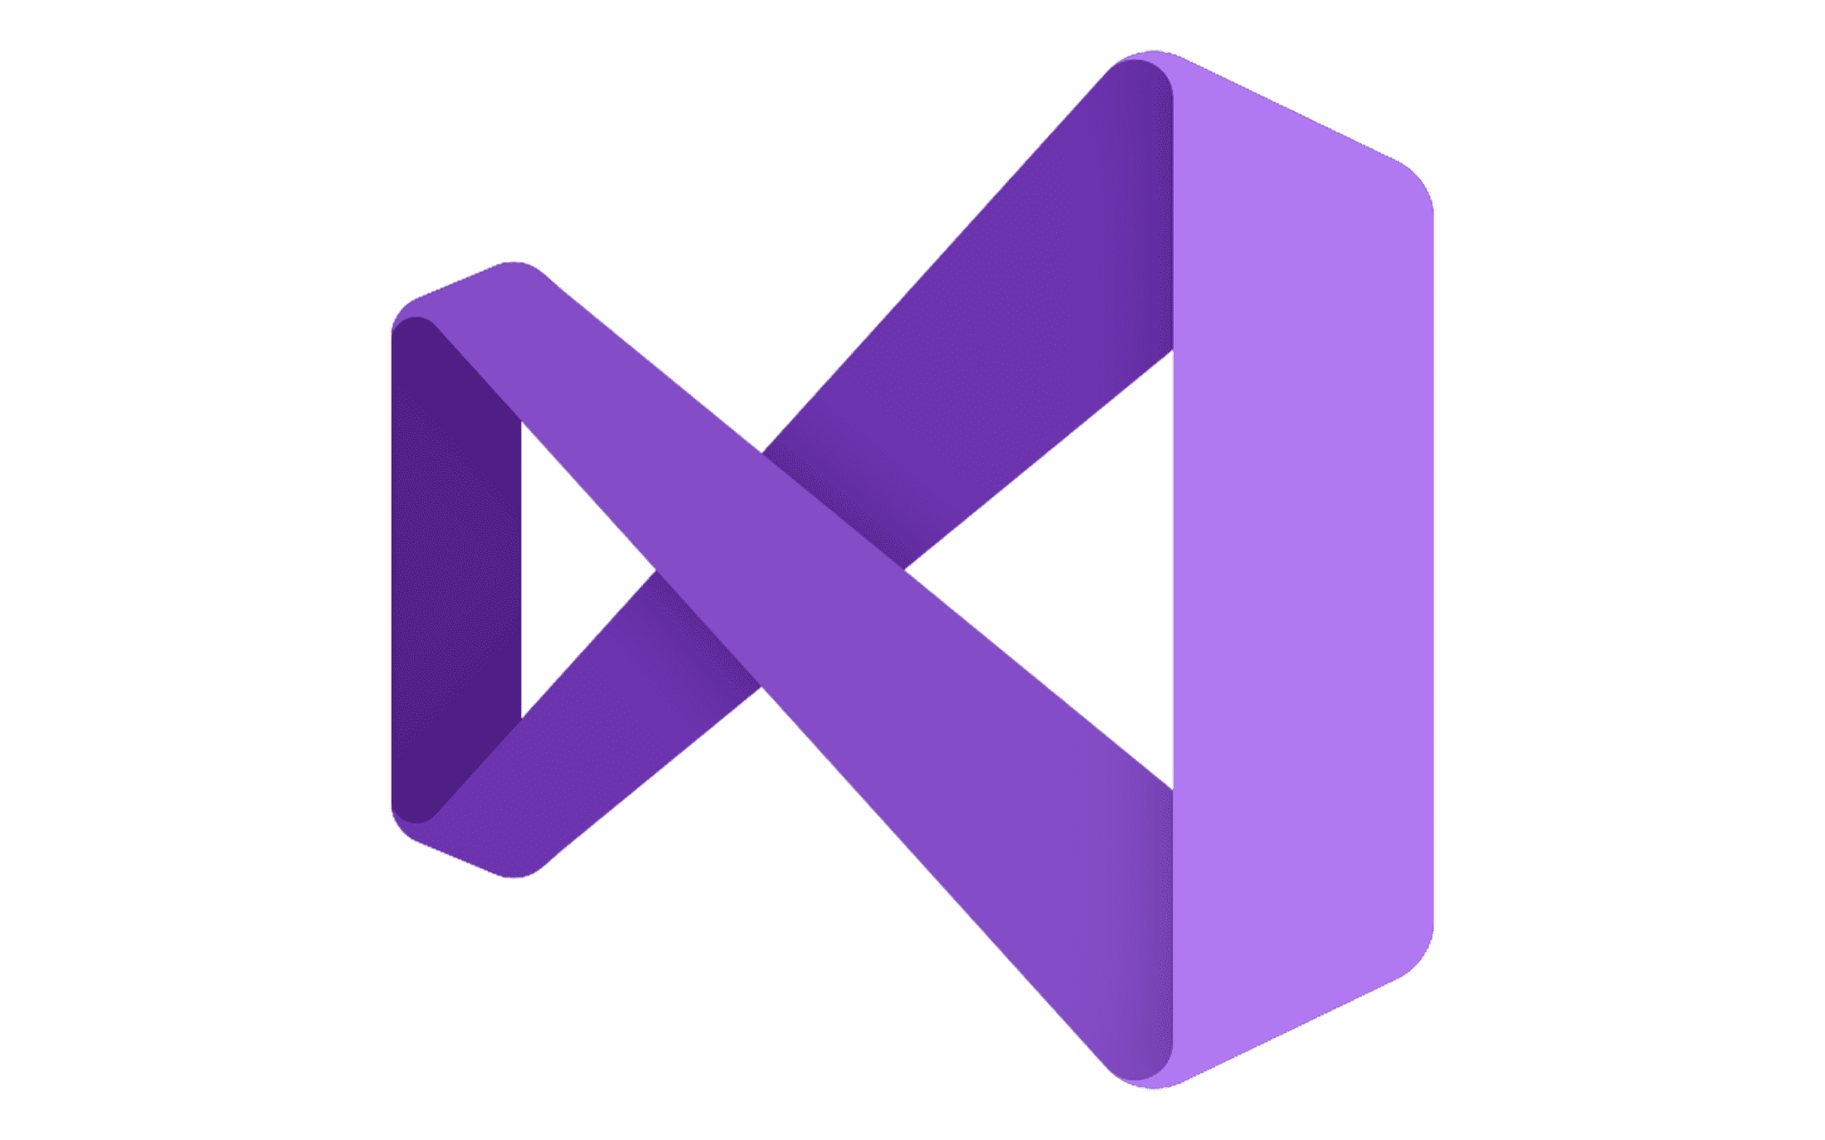


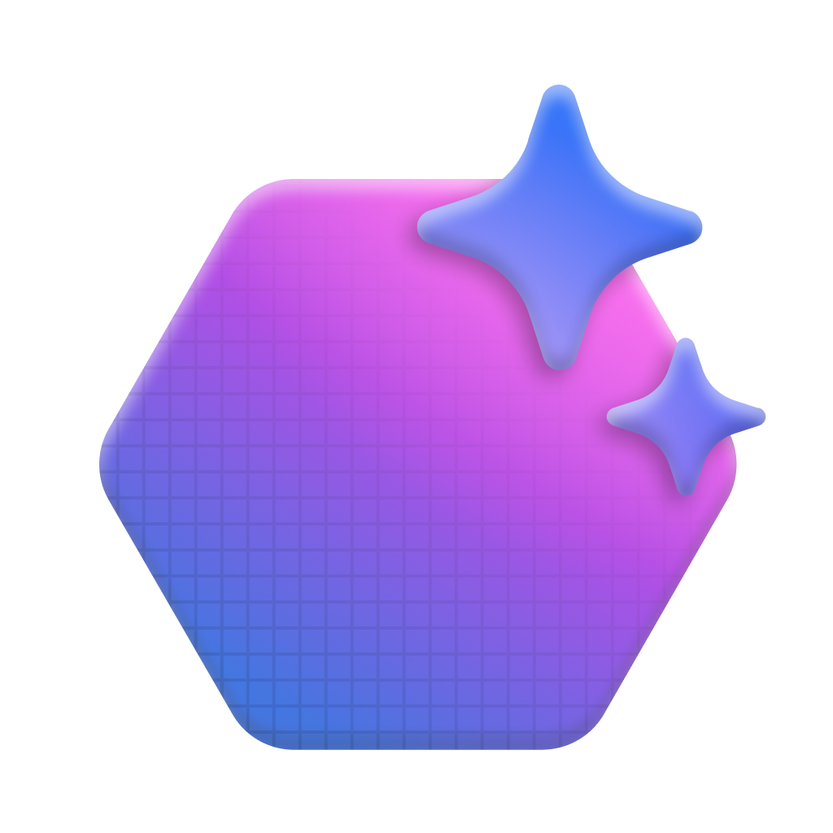



Microsoft Foundry Overview
Model Catalog
Copilot Studio
Foundational models
Open-source models
Task models
Industry models
Visual Studio
Azure OpenAI Service
Azure AI Search
Azure AI Agent Service
Azure AI Content Safety
GitHub
Evaluations
Customization
Governance
Monitoring
Azure AI Foundry SDK
Observability
CSCI E-94 Joseph Ficara Version 2.0.3 - Courtesy Microsoft Ignite BRK103.pptx

Slide 7
Microsoft Foundry - Overview What is it
Collaborative Project Management
Projects
Manage containers, resources, connectivity and security
Integration with Azure Services
AI services
Azure Storage
Databases

Slide 8









































Microsoft Foundry Overview
Ingest data
 | Microsoft Fabric |  | Azure SQL Database
 | Cosmos DB |  | Azure AI Search
 | Azure Redis |  | SharePoint
 | Bing |  | OSS Databases
Orchestrate with OSS frameworks
 | Semantic Kernel |  | LangChain
 | AutoGen |  | LlamaIndex
Open and Modular Platform
New Collaborations
Leverage Azure App Services
 | Functions |  | Kubernetes
 | Container Apps |  | Logic Apps
 | Dynamic Sessions |  | PubSub
Provision cloud resources
 | Compute |  | Storage
 | Data |  | Identity
 | App Hosting |  | AI Services
Monitor in production
 | Azure Monitor |  | Arize
 | Azure App Config |  | Weights & Biases
Microsoft Copilot Studio
Microsoft Power Platform
Azure AI Foundry portal
Azure Machine Learning
GitHub Enterprise
Visual Studio Code
Azure DevOps
Microsoft Azure Portal
CSCI E-94 Joseph Ficara Version 2.0.3 - Courtesy Microsoft Ignite BRK103.pptx

Slide 9
Microsoft Foundry - Overview
Diverse AI models
Over 11,000 models
Anthropic Claude
DeepSeek
Grok
Hugging Face
OpenAI
Microsoft
Mistral
Other open source and public models

Slide 10





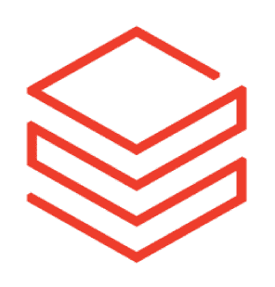




Microsoft Foundry Overview
Support for diverse selection of models
Now 11,299 + Frontier, task, and Open Models
OpenAI Model Family
(available day 1)
Phi SLM Model Family
Mistral AI Model Family
Meta Llama 2 Model Family
Jais G42 Model Family
Cohere Model Family
Databricks Model Family
Hugging Face Collection
New
New
New
Industry AI Models
CSCI E-94 Joseph Ficara Version 2.0.3 - Courtesy Microsoft Ignite BRK103.pptx

Slide 11
Microsoft Foundry - Overview What is it
Responsible AI
Content Safety
Input & Output filters
Safety validation

Slide 12



Microsoft Foundry Overview
Azure AI Content Safety
Harm categories
Groundedness detection
Prompt shields
Protected material detection
CSCI E-94 Joseph Ficara Version 2.0.3 - Courtesy Microsoft Ignite BRK103.pptx

Slide 13
Microsoft Foundry - Overview

Slide 14
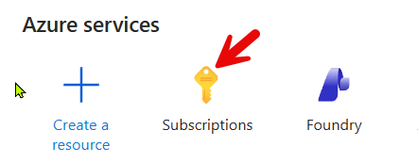
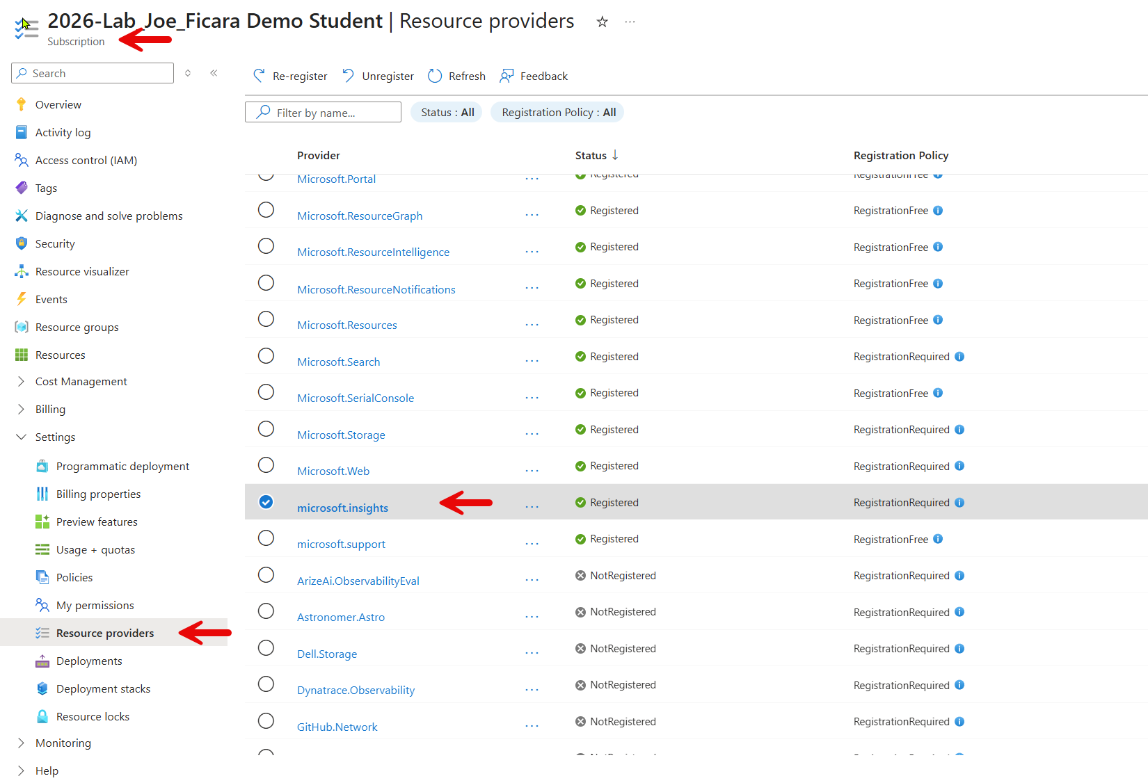
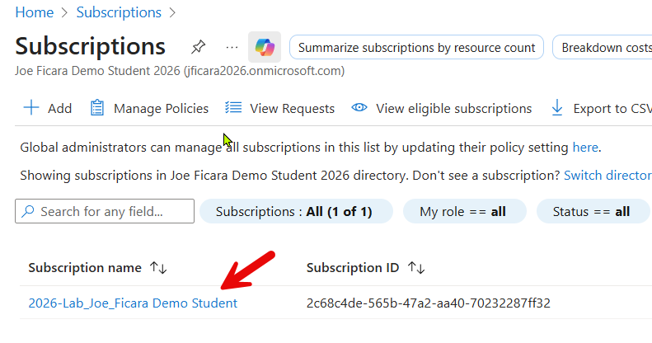
Creating a Foundry Resource
First register the microsoft.insights resource provider

Slide 15
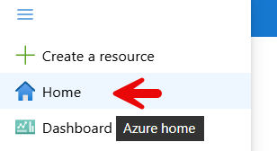
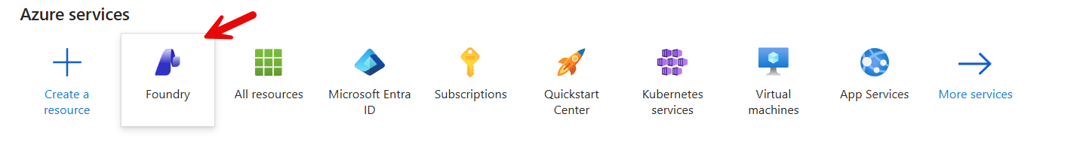
Creating a Foundry Resource
Next: Navigate to Home and choose Foundry

Slide 16
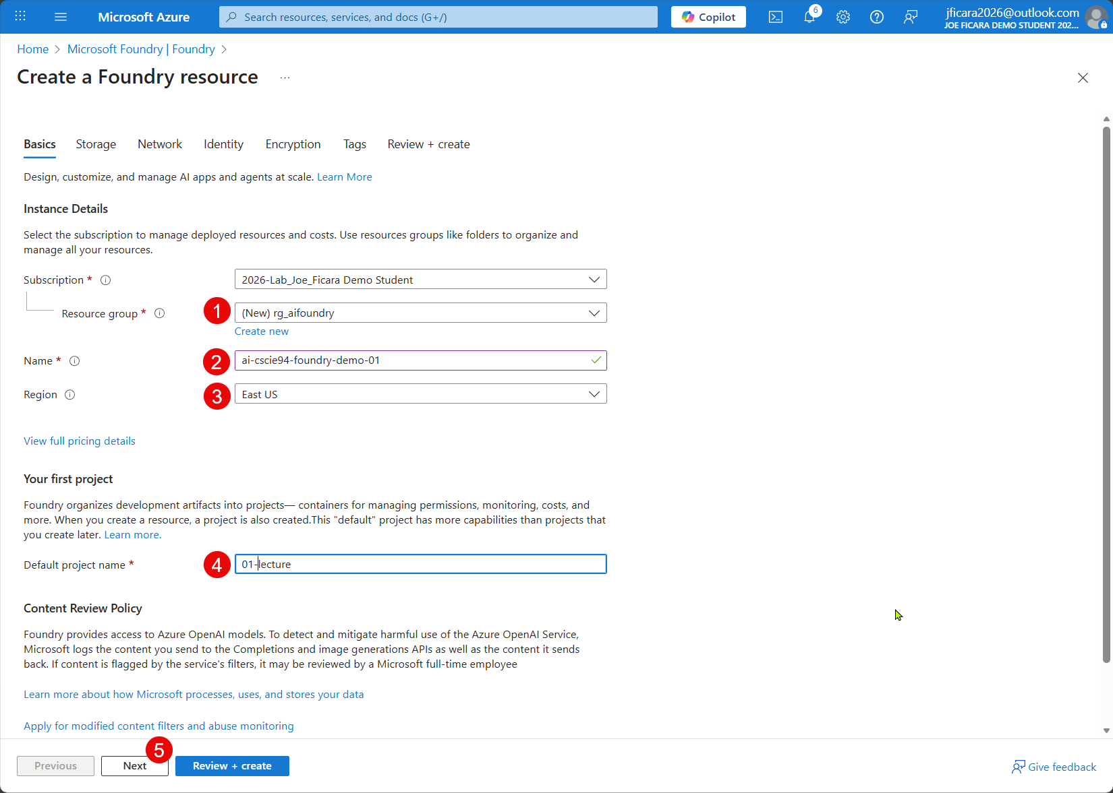
Creating a Foundry Resource
Fill out the card
Resource group,
Name
Region
East US2
Newer models
Default project name

Slide 17
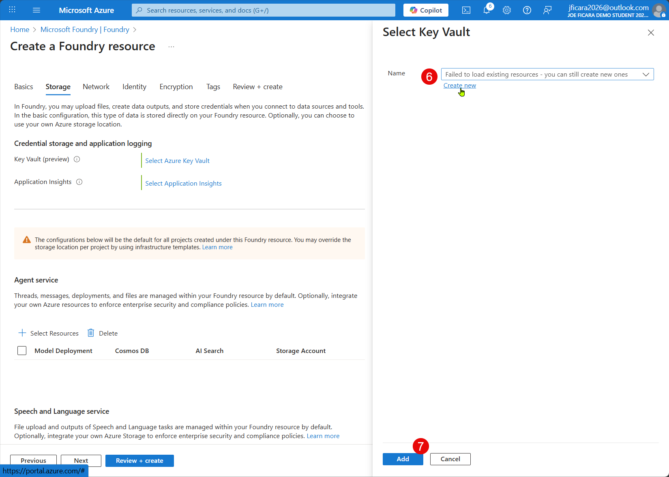
Creating a Foundry Resource
Setup KeyVault
Create new

Slide 18
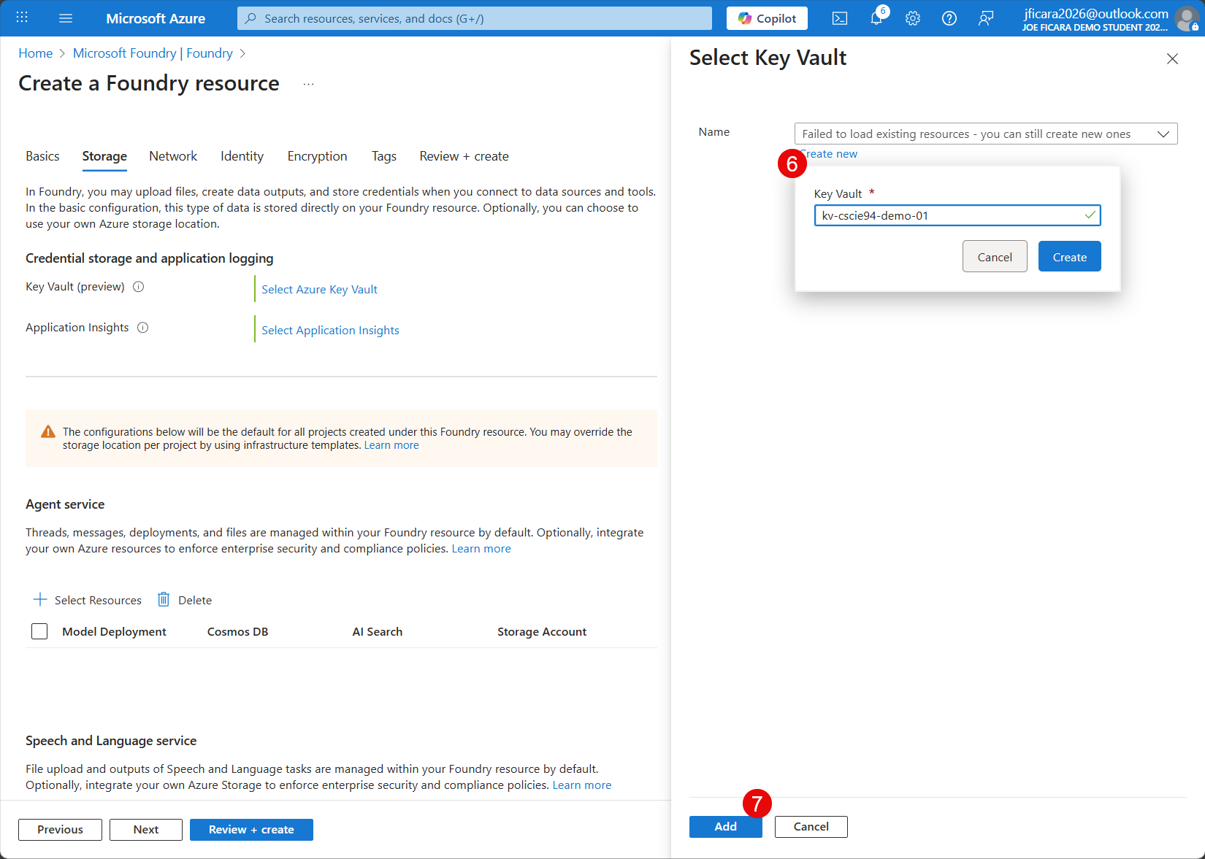
Creating a Foundry Resource
Setup KeyVault
Create new

Slide 19
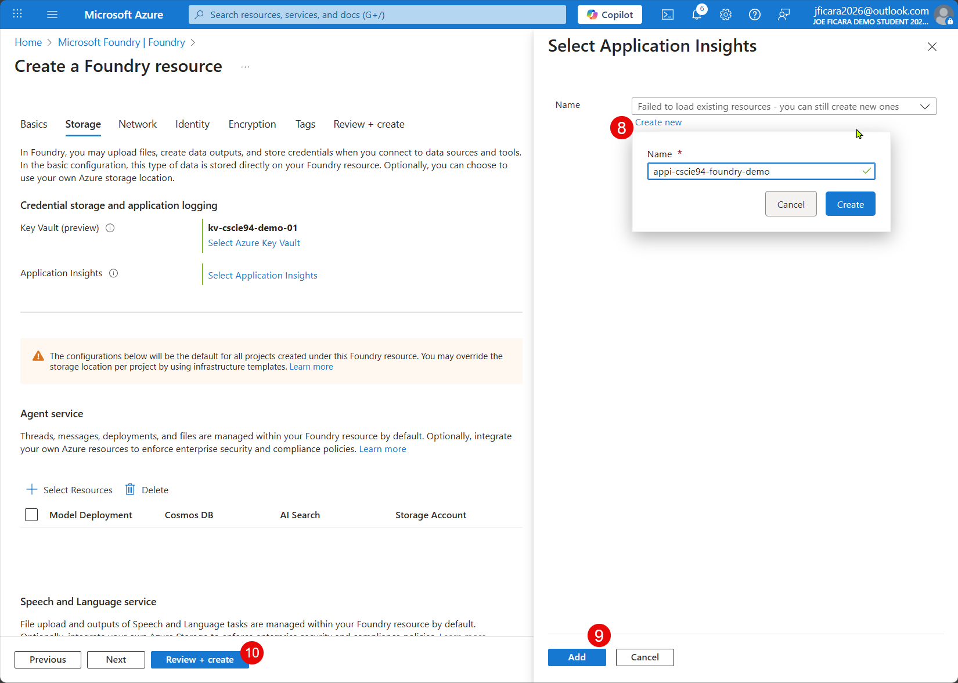
Creating a Foundry Resource
Setup
App Insights
Click
Review & create

Slide 20
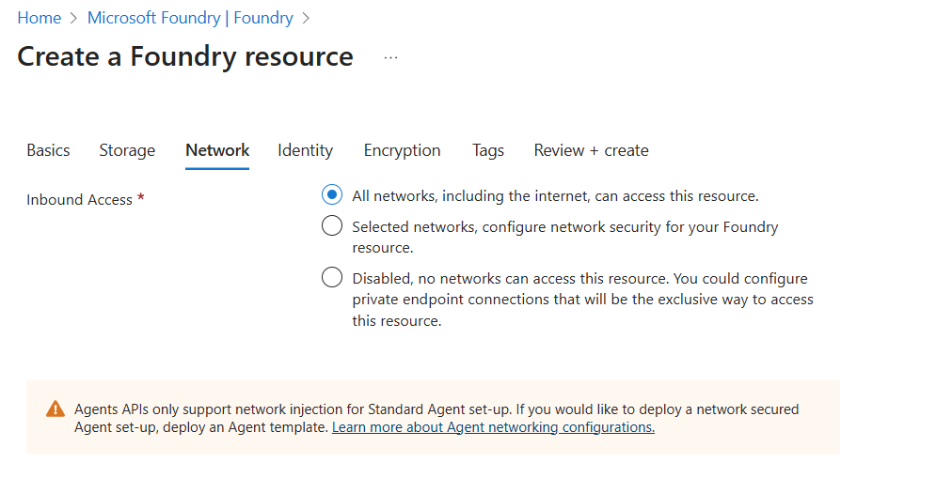
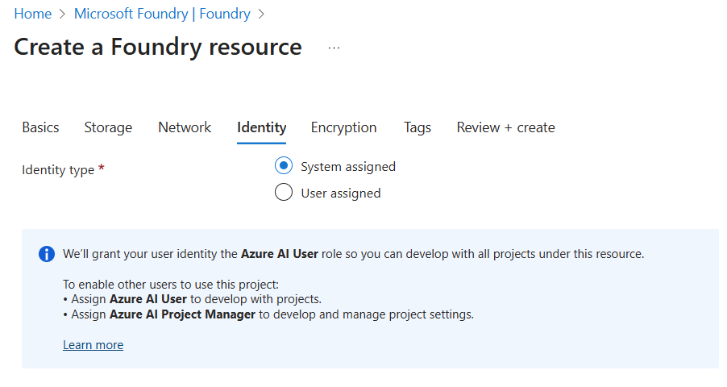
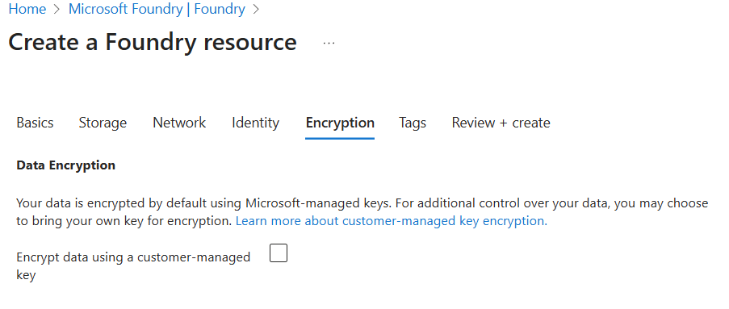
Creating a Foundry Resource
Review & Create - Accepts defaults for:
Network
Identify
Encryption
Tags

Slide 21
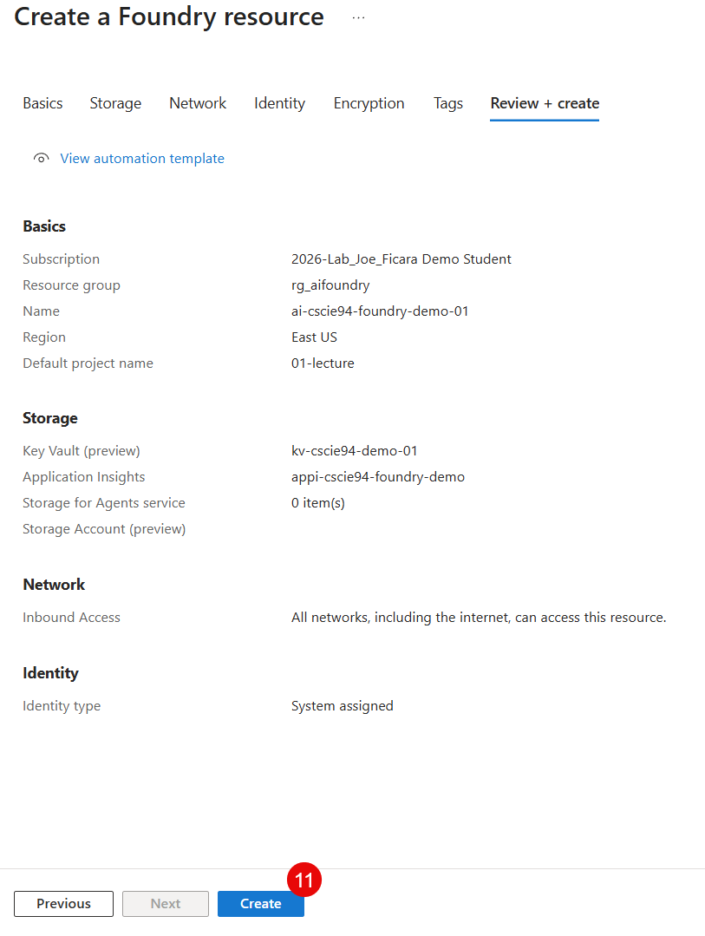
Creating a Foundry Resource
Review Summary
Click Create

Slide 22
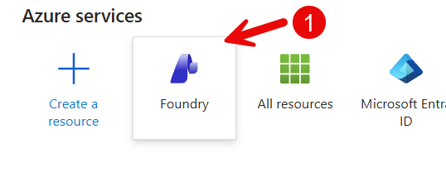
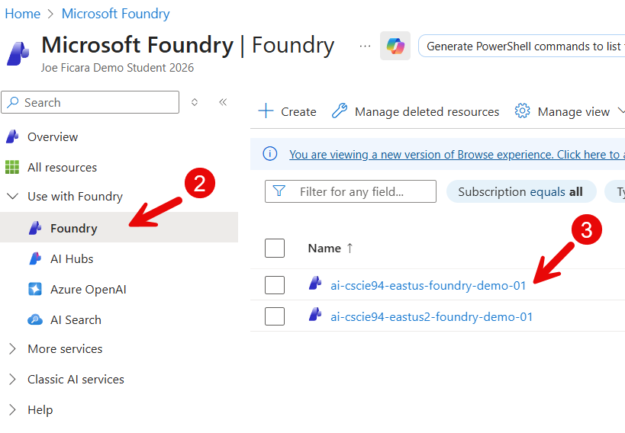
Configuring in Azure
Once deployed navigate to the Foundry UI
Pick your foundry instance

Slide 23
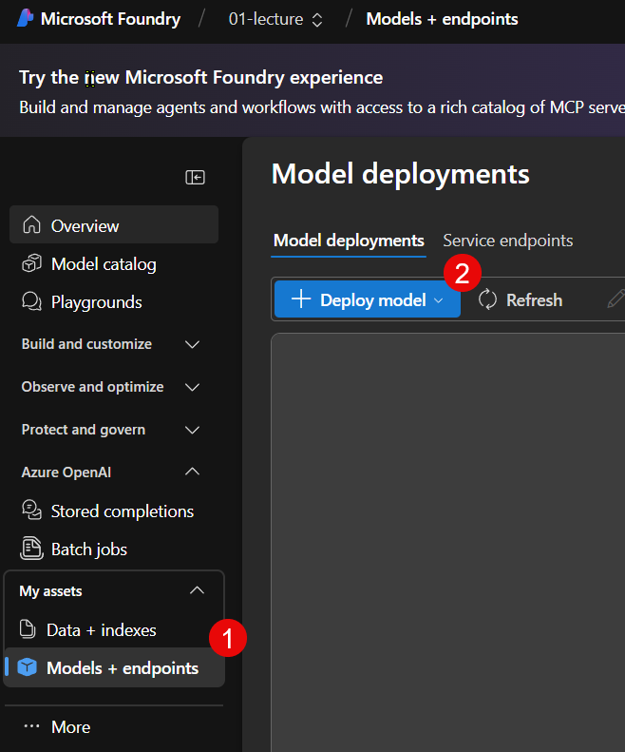
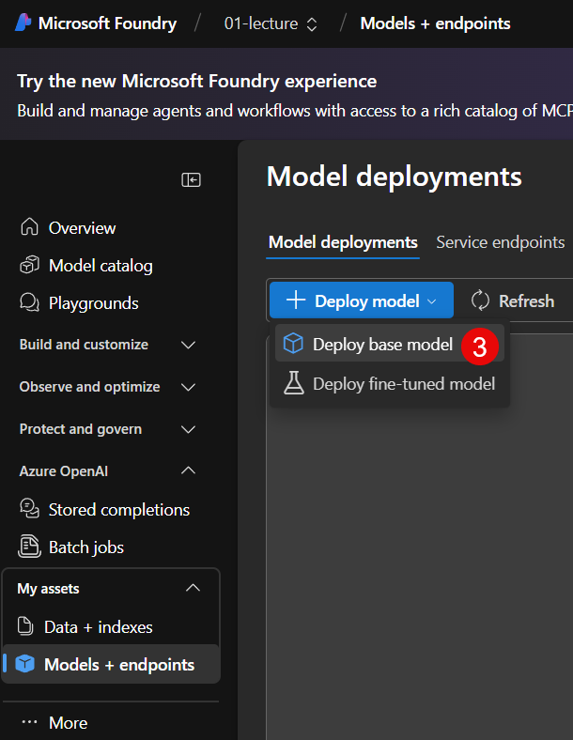
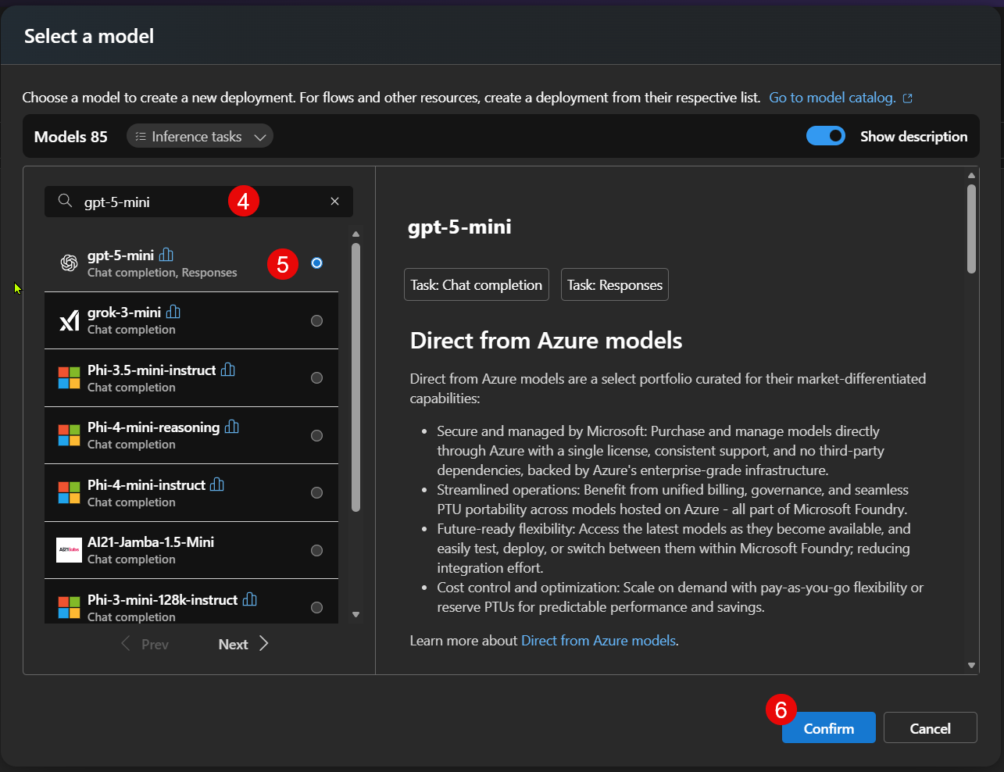
Configuring in Azure
Deploy a model
Pick gpt-5-mini

Slide 24
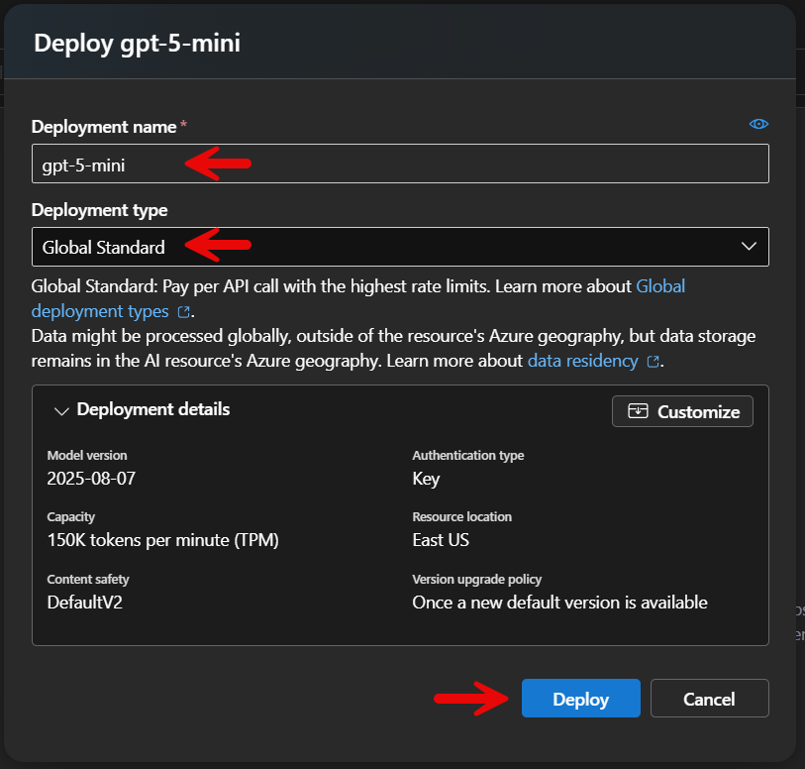
Configuring in Azure
Deploy a model
Enter a Deployment Name
Choose a deployment type

Slide 25
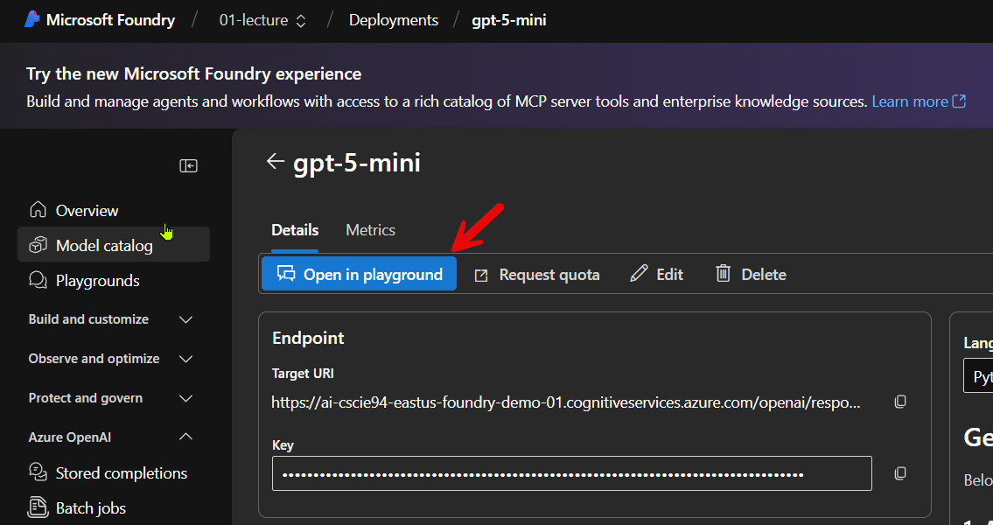
Test in playground
You can now experiment in the playground

Slide 26
Create Microsoft Foundry, Project & Test deployment
Azure Portal

Slide 27
Configuring in Azure

Slide 28


Let's Code!

Slide 29
Simple Chatbot
Basic Requirements:
Allow a caller to pass in a prompt
Using a POST request
Use an SLM to process the content of the prompt
SLM -> Small Language Model
Return the result from the SLM
To the caller

Slide 30
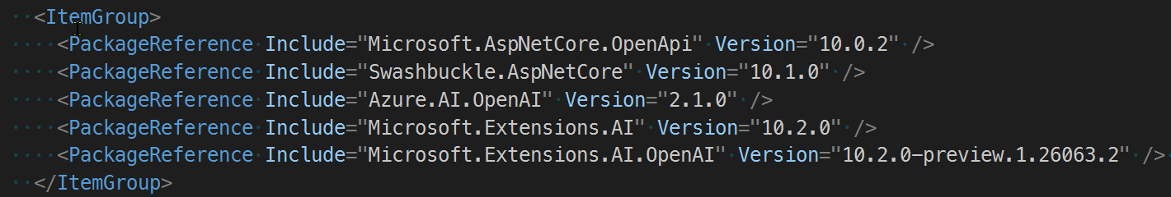
Simple Chatbot
Nuget packages needed

Slide 31
Simple Chatbot
How it works
Reads settings
Uri to your Azure OpenAI Service in the connected resources
ApiKey to access the model
Connect to a deployed gpt 5 mini SLM
Using the settings defined by the AISettings
Passes the string provided in the body of the POST request
To the SLM
Returns result from the SLM
As the result of the POST request

Slide 32
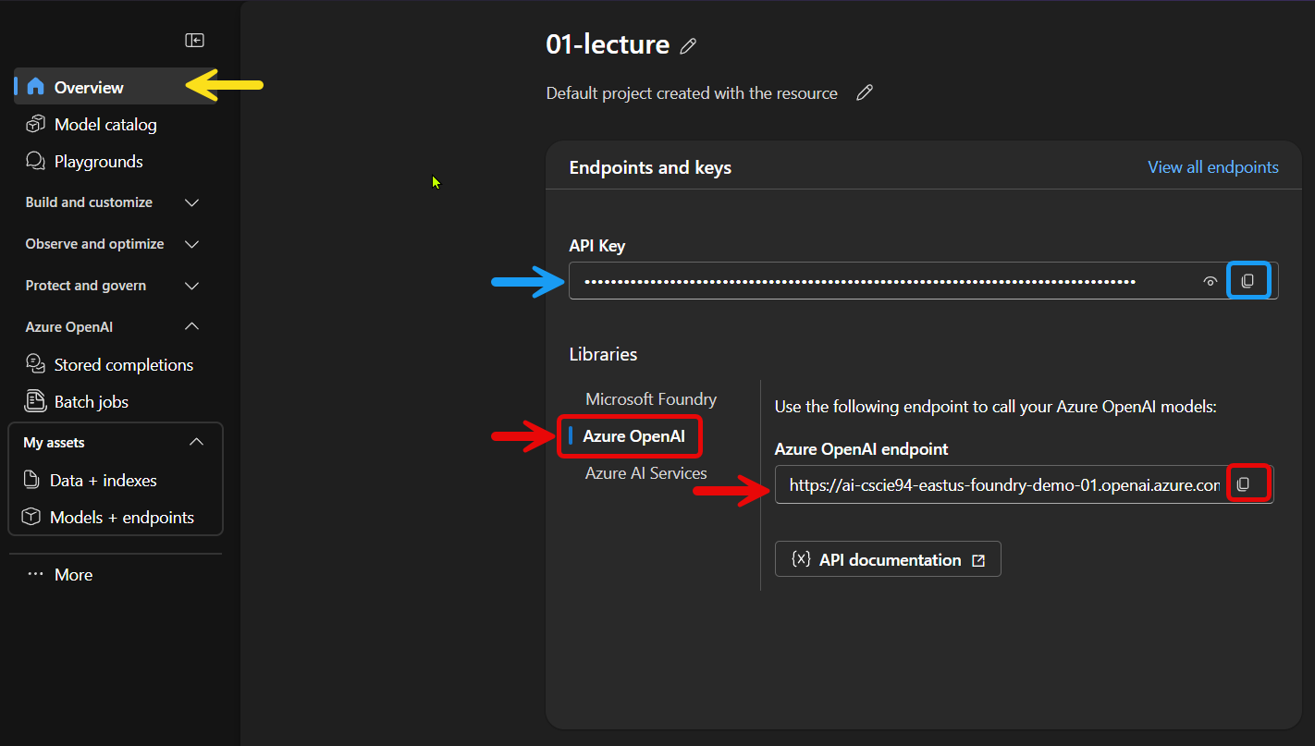
Test in playground
URL and API Key
Be sure to choose OpenAI to obtain the correct URL!

Slide 33
Simple Chatbot
How do you do it?
Get an instance of IChatClient
Using dependency injection, in your controller's constructor
Create a ChatOptions
Include settings to direct the SLM
Temperature (GPT 5 mini only accepts a Temperature of 1)
The randomness of the SLM/LLM's responses
Lower values = more deterministic
Higher values = increase creativity
MaxOutputTokens
Maximum number of tokens the SLM/LLM can generate in a response

Slide 34
Simple Chatbot
Submit the prompt
Using IChatClient instance & GetResponseAsync method
Provide
The ChatOptions instance
The prompt provided by the call to the REST API
Return the result from the SLM
To the caller

Slide 35
Simple Chatbot
SimpleWebAPIChatDemoSolution.sln
SimpleWebAPIChatDemo.csproj

Slide 36
Structured Output JSON
Why structured output?
Facilitates integration into your business logic
Makes it easier to deal with results
Strongly typed output
How do you do it?
Get an instance of IChatClient
Using dependency injection
In your controller's constructor

Slide 37
Structured Output JSON
Nuget packages needed

Slide 38
Structured Output JSON How do you do it …
Create the shape you expect to be returned
A public C# Class with public properties
Used to define the JSON structure to be returned
Generate the JSON Schema
Using Nuget package NJsonSchema
Create a ChatResponseFormatJson instance
Supply the schema
That defines the desired output format

Slide 39
Structured Output JSON How do you do it …
Create a ChatOptions
Specify the ResponseFormat
With the ChatResponseFormatJson instance
Include settings to direct the SLM
Temperature
The randomness of the SLM/LLM's responses
Lower values = more deterministic
Higher values = increase creativity
MaxOutputTokens
Maximum number of tokens the SLM/LLM can generate in a response
Etc…

Slide 40
Structured Output JSON How do you do it …
Submit the prompt using GetResponseAsync
Include the ChatOptions instance
Include an enhanced user prompt $"Identify and return a JSON list of the most important 3 key phrases from the following text: {prompt}";
The prompt in the interpolated C# string is the input from the user

Slide 41
Structured Output JSON
StructuredOutputWebAPISolution.sln StructuredOutputWebAPI.csproj

Slide 42
Questions

Slide 43
Further Reading
Microsoft Foundry
What is Microsoft Foundry? - Microsoft Foundry | Microsoft Learn
Microsoft Foundry architecture - Microsoft Foundry | Microsoft Learn
Microsoft Foundry frequently asked questions - Microsoft Foundry | Microsoft Learn

